Slide 1
Mental Health Computing via Harvesting Social Media Data
Jia Jia
jjia@tsinghua.edu.cn
Tsinghua University
02/08/2018

Slide 2
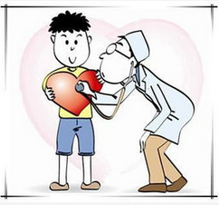
Mental Health
Mental health is a level of psychological well-being, or an absence of mental illness.
The WHO states that the well-being of an individual is encompassed in the realization of their abilities, coping with normal stresses of life, productive work and contribution to their community.
Notes:
Mental health is a level of psychological well-being, or an absence of mental illness.
The WHO states that the well-being of an individual is encompassed in the realization of their abilities, coping with normal stresses of life, productive work and contribution to their community.
And our topic of mental health will begin with stress as an specific example.

Slide 3
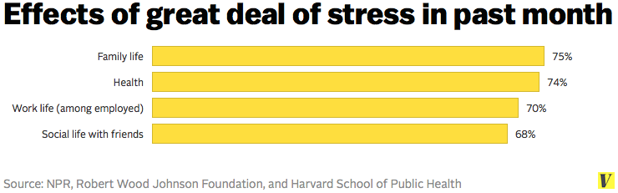
What is Stress?
Hans Selye in 1936: “Stress is the non-specific response of the body to any demand for change”
Stress
can be caused by common life events like work, family, financial problems, etc
Notes:
In 1936, a very famous phycologist hans sally proposed the first definition of stress: Stress is the non-specific response of the body to any demand for change
Stress can be caused by many common life events like work, financial problems and so on.

Slide 4
Is Stress clinical?
No! But
Chronic and excessive stress can cause
Physical symptoms: headache, insomnia, weight problems, heart diseases, etc
Mental symptoms: disorders, depression, anxiety, agitation, etc
Excessive stress is also causing severe social problems
41149 suicides in 2013 in America, 10th cause of death
Mental illness, contributes to 90% of completed suicides.
Cases:
Foxconn’s serial jumping suicides;
Karoshi 2011;
it is of significant importance for social good and wellness to detect and relieve stress before it leads to more severe problems!
Notes:
Stress itself is a non-clinical thing, while chronic and excessive stress can cause many physical and mental health problems, threatening people’s health.
Moreover, excessive stress would cause many social problems or even lead to suicide.
That is terrible. So, it is of significant importance for social wellness to detect and relieve stress before it leads to more severe problems.

Slide 5
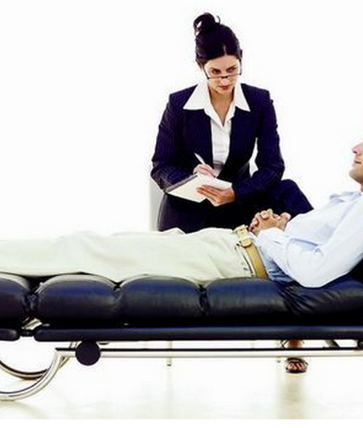
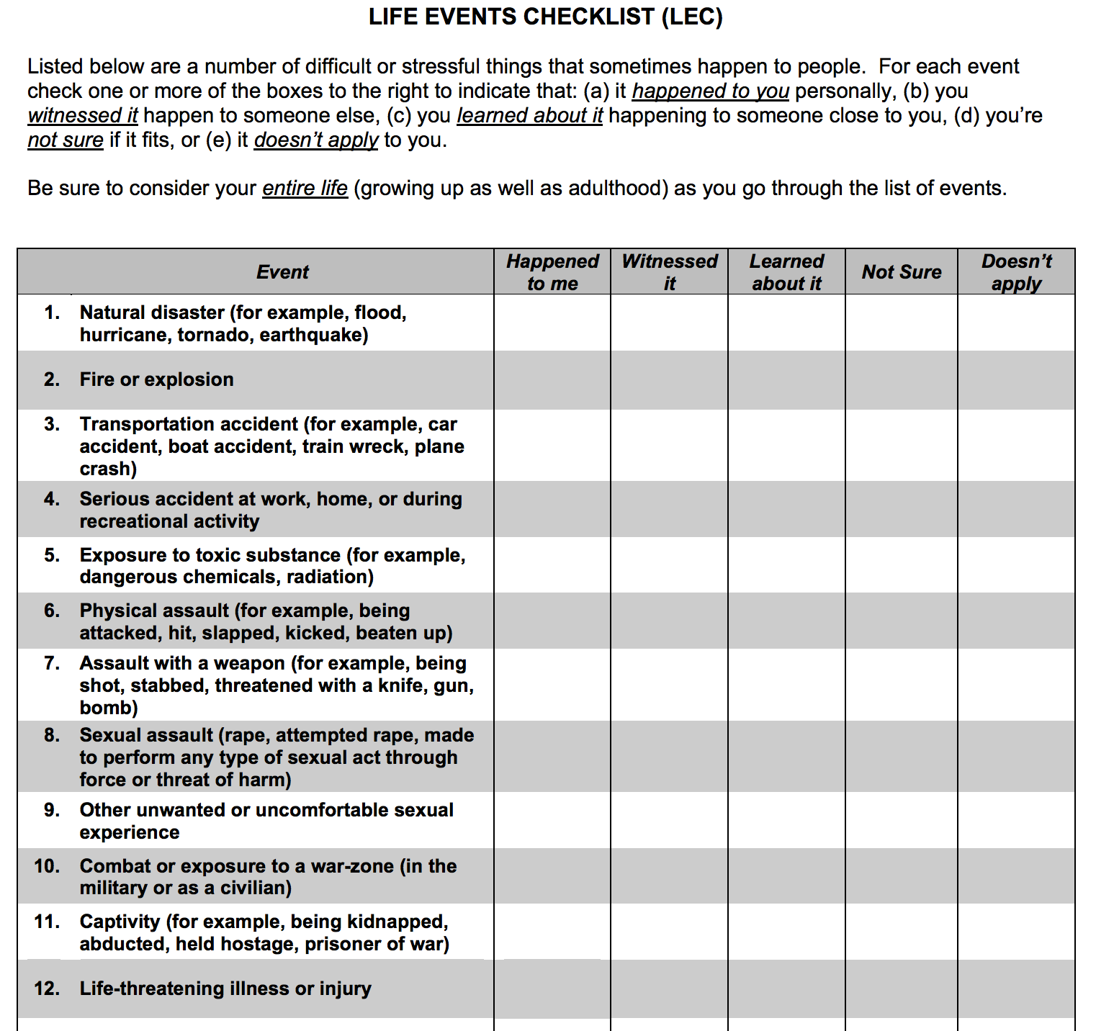
How?
Traditional stress detection methods
Face-to-Face Interview by professional psychologists
Self-report Questionnaires
Binary: stressed or non-stressed
Scale: a score indicating the psychological stress level
LEC, PSS, CPSS, The Holmes Rahe Life Stress inventory, etc
Notes:
But how? In the past decades, many efforts have been devoted to developing stress detection tools and methods. The main one is Face-to-Face Interviews by psychologists. And sometimes, the interview will be started from a Self-report questionnaire with either binary results or a score indicating the psychological stress level.

Slide 6
Can we make the mental health care from reactive care to proactive care?
Social media is changing the ways people do with their healthcare and wellness
Notes:
Both face to face interviews and self-reported questionnaires are professional and reliable. But in this way, stress detection is under reactive care. We are wondering: can we。。。？

Slide 7
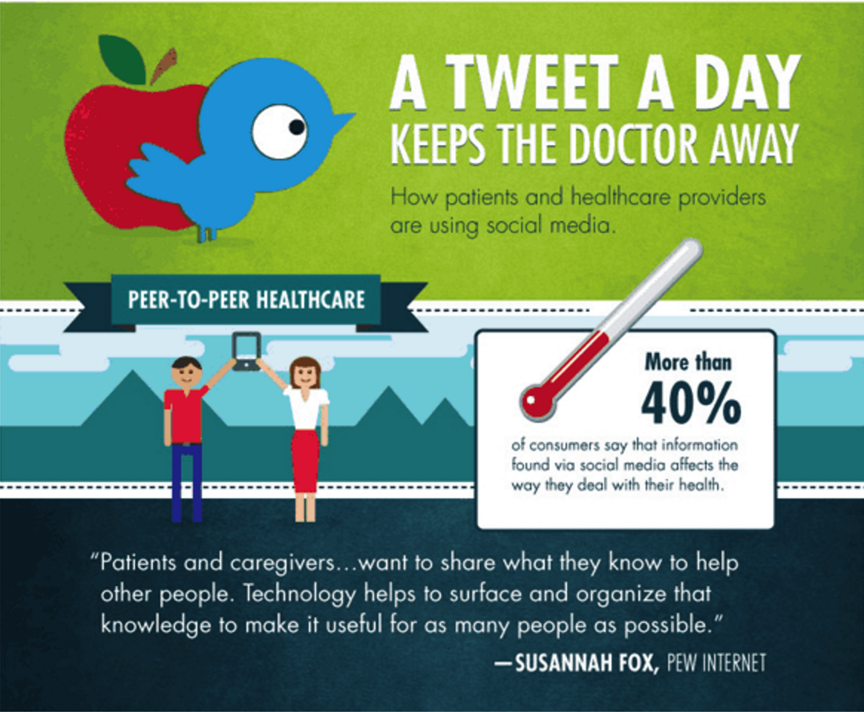
Social Media
The influence of Facebook, Twitter, YouTube and other social media giants has spread across modern society faster than the Black Death swept across 14th century Europe.
http://www.alliedhealthworld.com/visuals/tweet-day-keeps-doctors-away.html
Notes:
social media is changing the ways people do with their healthcare and wellness. For example, a tweet a day, keeps the doctor away. A survey conducted by alliedhealthworld says there are more than 40% of consumers will find information about health by social media and also report their health conditions by social media.
This phenomenon inspires us that we should consider the social media content for infering users’ health conditions.

Slide 8
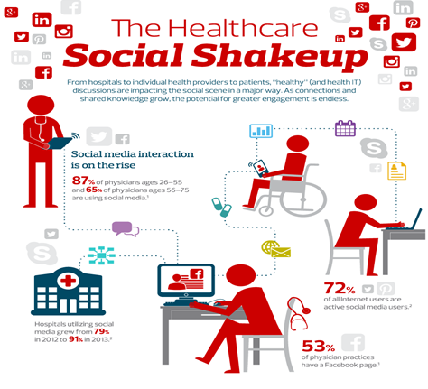
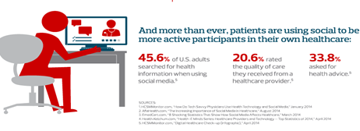
CDW Healthcare saying that social media is changing the ways of healthcare, from health communication to patient care
http://www.cdwcommunit.com/resources/infographic/social-media/
Notes:
CDW Healthcare summarizes that social media is changing the ways of healthcare, from health communication to patient care. So we can see that social media is playing an important role in healthcare area.

Slide 9
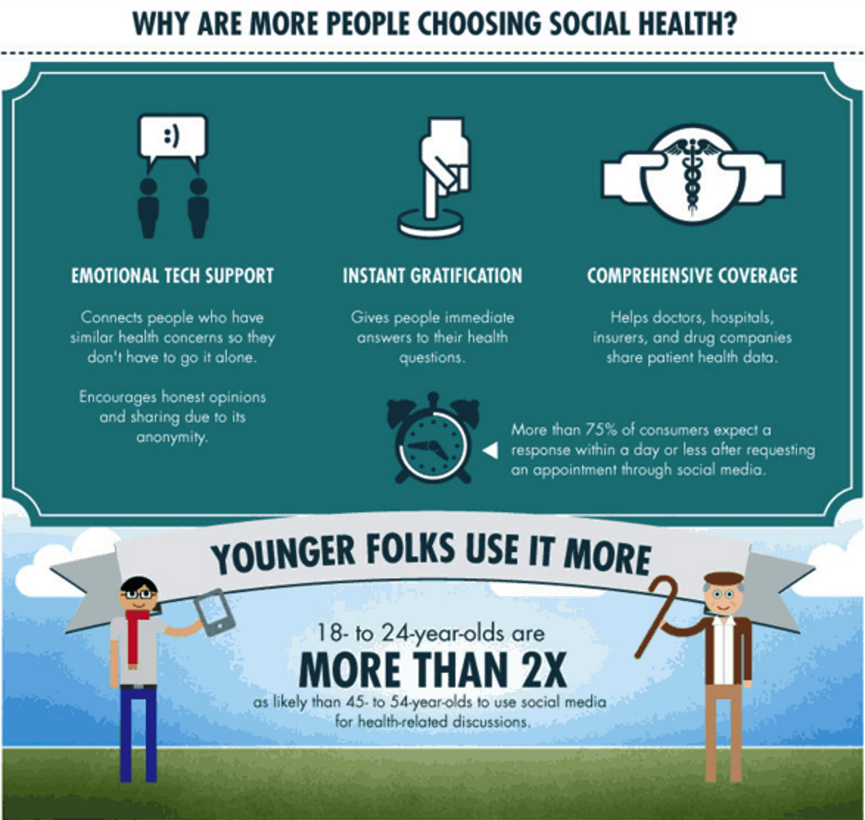
Social Media
People are forming online support groups, becoming better educated on medical topics and diagnoses, and sharing reviews – wherever and whenever they want.
http://www.alliedhealthworld.com/visuals/tweet-day-keeps-doctors-away.html
Notes:
And more important, people are forming online support groups, especially emotional tech support groups. The groups connect people who have similar concerns so they don’t have to go through it alone. This also inspire us that besides social media content, the social structures of the users are also very important, and should be considered in our task.

Slide 10
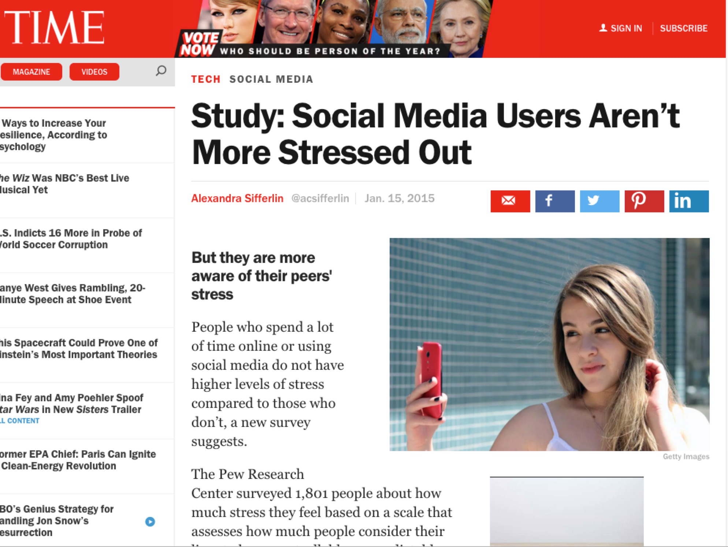
http://time.com/3668183/stress-social-media/
Notes:
And sometimes social media plays an positive role in healthcare

Slide 11
Health 2.0.
The Economist (2007)
Researchers started to notice the rise of “user-generated content”
Public Mental Health Care
Using social media data for suicide monitoring in public
2007
Personalized Health Care via Multi-source, Multimedia data
2013
Individual Mental Health Care
Using social media data for emotions, depress or stress detection
2011
Future
Present
Disease Detection & Tracking for Public Physical Health Care
Using social media data to predict outbreaks of epidemics
Notes:
From the academic point of view, we can summarize the relation between social media and healthcare in this way.
The concept of “Health 2.0” was introduced in 2007 by the Economist magazine. Researchers started to notice the rise of “user-generated content”
And in 2011, researchers started to study Disease Detection & Tracking for Public Physical Health Care, using social media data to predict outbreaks of epidemics.
In 2013, public mental health care began to appear, social media data was used for suicide monitoring in public.

Slide 12
Milestone
Leveraging Social Media for Mental Health Care
Hawton investigated the suicide factors in adolescents via keywords from several social media websites. (2012, Lancet)
Won built a model to predict the suicide numbers in America via social media data. (2012, PLOS ONE)
De Choudhury has tried to leverage Twitter data to predict depression.(2013, ICWSM)
Harman tried to leverage twitter data to quantify the mental health signals of users. (2014, ACL)
System: Moodscope (MSRA) and Suicide Intervention (Google, Facebook, Instagram)
Notes:
Besides these works, I also want to show more research works by using social media data for mental health care, regarding the suicide factors, depression and mental health signals.

Slide 13
Suicide Intervention
Notes:
As for suicide intervention, When users search “suicide” in google,

Slide 14
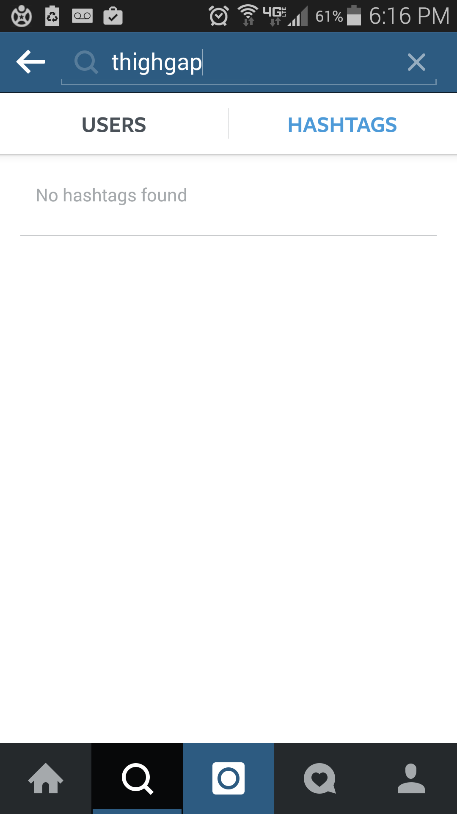
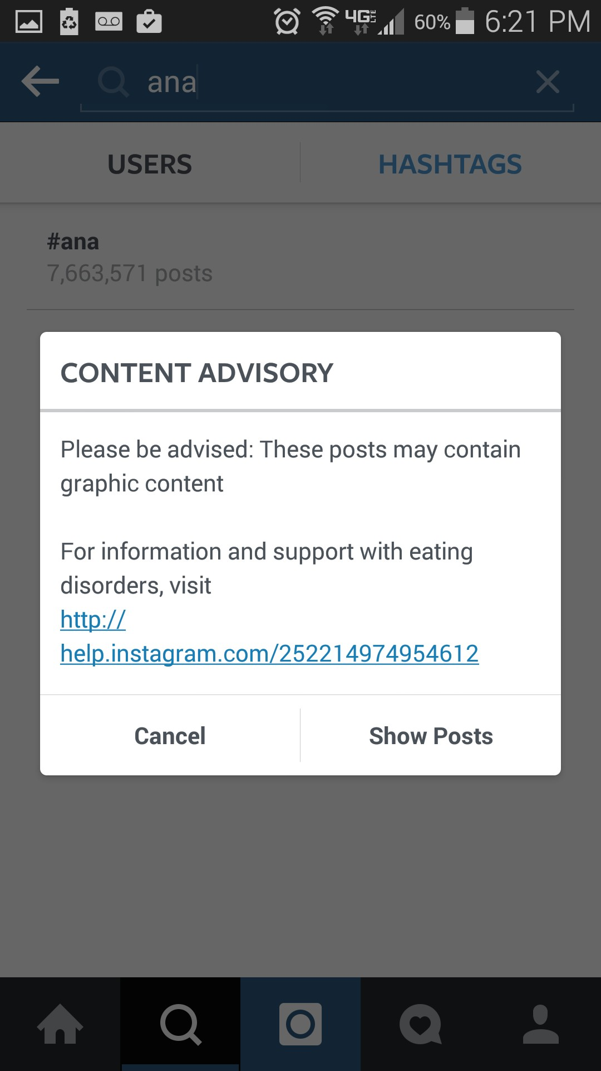
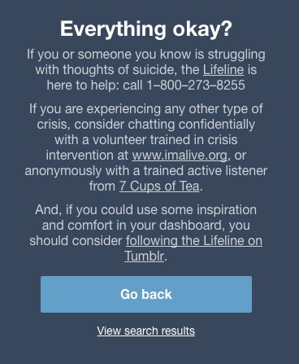
Suicide Intervention
The app would alert users that if everything’s fine and if he/she needs advisory or help. This is a humanized progress.
Notes:
or when users search “suicide” related hashtags in Instagram, the app would alert users that if everything’s fine and if he/she needs advisory or help.
I think this is a humanized progress

Slide 15
Our Research Outline
Stress Detection via Harvesting Social Media
Binary Stress Detection Based on Social Interactions (ACM Multimedia’14)
Beyond Binary Classification: Stressor and Stress Level Detection (IJCAI’16 )
From Stress Detection to Depression Detection
Binary Depression Detection : A Multimodal Dictionary Learning Solution (IJCAI’17)
Depression Detection on More Platforms : Cross-Domain Depression Detection (IJCAI’18)
Notes:
I just gave a detailed review on social media and health care, and using social media data for stress detection. Next, I will introduce some of our work in details.
Via harvesting social media data, we comprehensively study the detection of mental wellness, with two typical mental problems, stress and depression, as specific examples. Initializing with binary user-level detection, we expand the research towards detecting the trigger and level of mental problems with stress as an example. We also explore cultural differences by enhancing detection performance with cross-domain datasets and validating our method in depression detection.

Slide 16
Research 1： Stress Detection via Harvesting Social Media
Notes:
We first devote efforts to binary user-level psychological stress detection.

Slide 17
Dataset & Labeling
We establish a dataset including 400 million tweets from Sina Weibo, Tencent Weibo and Twitter
3 methods to label the dataset
Sentence pattern
Hashtags
Professional stress scale
Notes:
Since mental disorders are usually continuous and chronic, we study each user by gathering a period of one week of tweet data.
We construct a dataset including 400 million tweets from Sina Weibo, Tencent Weibo and Twitter. We employed 3 methods to label the dataset.

Slide 18
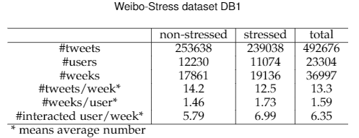
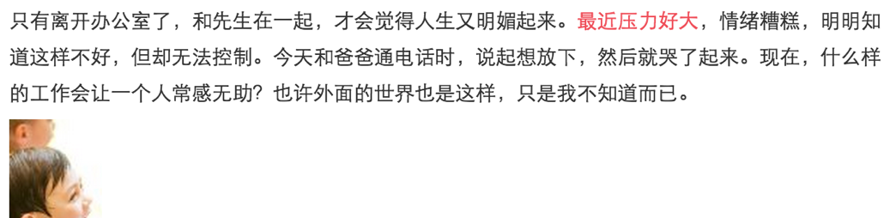
Labeling
Sentence pattern
“We Feel ***” and Searching the Emotional Web (SD Kamvar, 2011)
“I feel stressed”, “I feel relaxed”
“最近压力好大”, “最近压力很大”
Notes:
First, self-reported sentence pattern labeling, matching expressions like ”I feel stressed or I feel relaxed” in UGC. And we obtain about 11 thousand stressed users and 12 thousand non-stressed users.

Slide 19
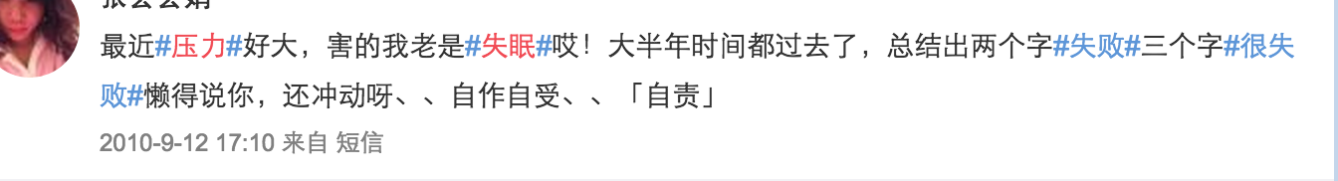
Labeling
Hashtags
Using Hashtags as Labels for Supervised Learning of Emotions in Twitter Messages (M Hasan, 2014)
Notes:
The second way is to use the hashtags. Inspired by the affective computing work by Hasan in 2014, we select the tweets with stress-related words in their hashtags, and divide them into six categories.

Slide 20
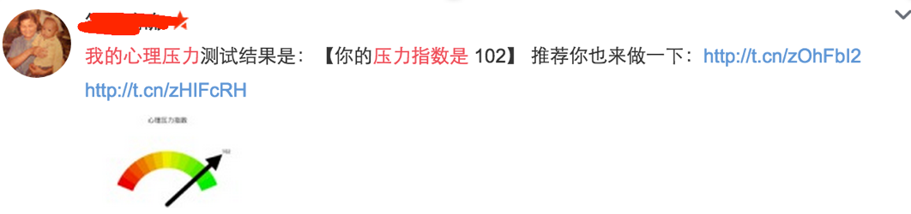
Labeling
Professional stress scale
Some people would like to do professional stress scale tests and share the results to social media platforms, like PSTR
Notes:
The third way is by Professional stress scale. Some people would like to do professional stress scale tests and share the results to social media platforms, like PSTR. And we gather a dataset of about 200 users. We believe that, this is a small but reliable dataset.

Slide 21
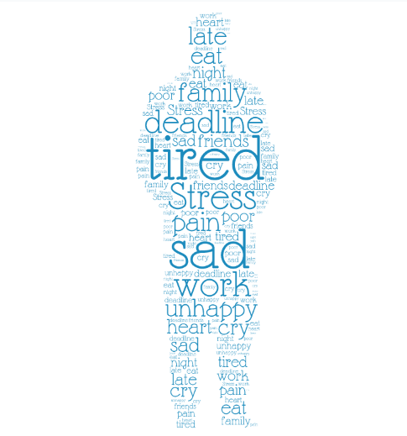
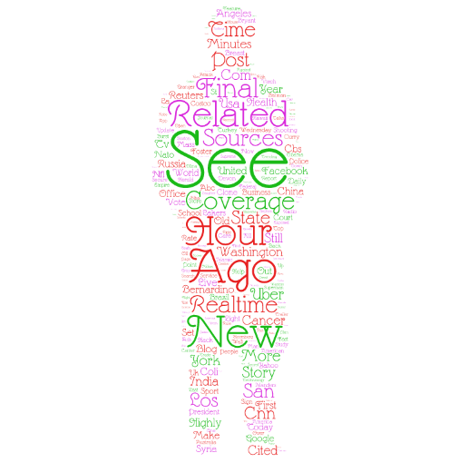
Data Observation on Self- Reported Stressed and non-stressed users
10k tweets which are labeled as stressed ones vs. randomly sampled tweets from twitter
Lin & Jia. Detecting Stress Based on Social Interactions in Social Networks. TKDE 2017.
Notes:
We perform Data Observation on Self- Reported Stressed and non-stressed users.
The left is sampled from the about 10 thousand tweets which are labeled as stressed ones.
The right is randomly sampled from twitter.
We can see that, depressed users tend to use more negative words like tired and sad, which is quite different from the normal users.

Slide 22
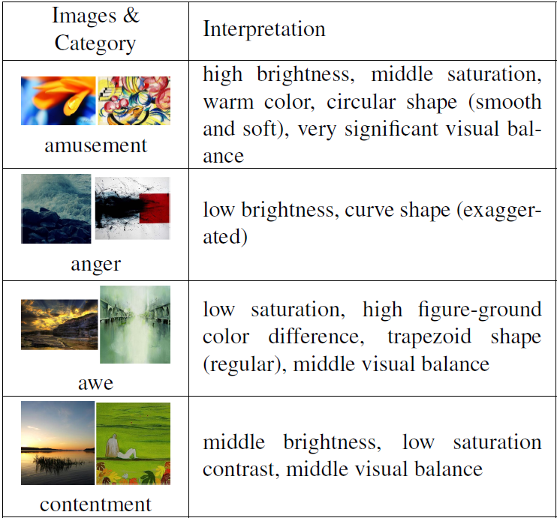
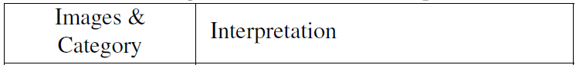
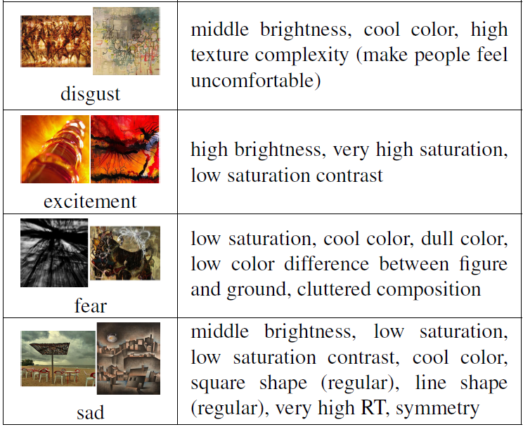
Data Observation (Image)
Colors in images are related to emotions [S. R. Ireland etc., 1992], [Kobayashi, S. etc., 1991]
Lin & Jia. Detecting Stress Based on Social Interactions in Social Networks. TKDE 2017.
Notes:
We also analyze the images, which according to previous researches, are closely related to emotions.
We can see that, different images can express different emotions, like amusement, disgust, excitement and so on.

Slide 23
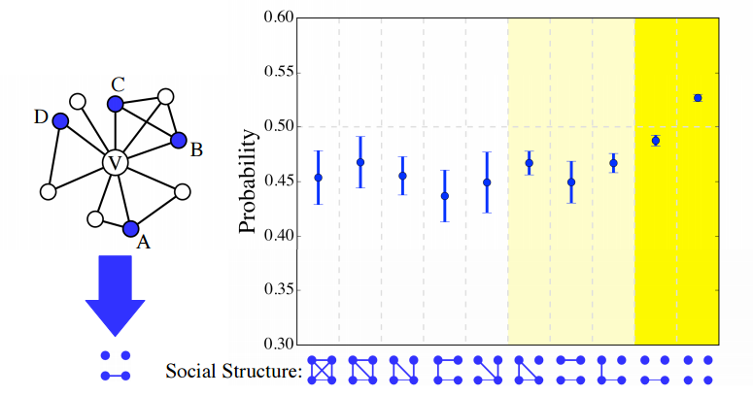
Data Observation (Social Structures and User Interactions)
The social structure of stressed users’ friends tends to be less connected and less complicated, compared to non-stressed users.
Lin & Jia. Detecting Stress Based on Social Interactions in Social Networks. TKDE 2017.
Notes:
We use the social networks of users in dataset DB1 to study the structural pattern in friends’ connection. Based on the following link, the top four users with the most frequent interactions in the sampling period are selected, which may concisely produce 10 different structural combinations. We compare the proportion of different social structures of interacting users to measure the structural diversity, and see notable differences between the stressed and non-stressed users. The number of sparse connection in stressed users’ social structures is much higher than that of non-stressed users’, indicating that the social structure of stressed users tends to be less connected and less complicated.

Slide 24
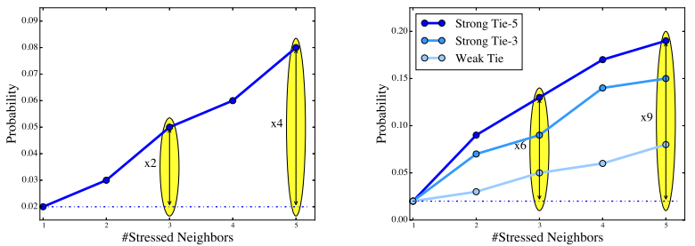
Feasibility – Data Discrimination (Social Structures and User Interactions) (cont.)
The chance that a none-stressed user becomes stressed increases to three times higher for a user with stressed neighbors than for one without stressed neighbors.
The likelihood of a user being stressed increases with the number of stressed neighbors.
Lin & Jia. Detecting Stress Based on Social Interactions in Social Networks. TKDE 2017.
Notes:
The principle of social influence suggests that users tend to change their behaviors to match those of their friends. We study the probability variation of one user’s stress state when the user has different types of relationship with other stressed users. According to our statistical result, the chance that a user becoming stressed grows sharply with the increasing number of stressed neighbors in his / her social network . We also investigate the social influences by classifying the social relationships into strong and weak. We find that, strong ties have strong influence on users’ stress states, while the influence of weak ties is rela-tively weak. These insights verify that mental wellness is mu-tually correlated and point towards the need for further study over the online contagion of mental health problems.

Slide 25
Tweet-level Content Attributes
 | Attributes | # | Introduction
Text Attributes | Emotion Words | 2 | Positive and Negative Emotion Words
 | Emoticons Numbers | 2 | Number of Positive and Negative Emoticons
 | Punctuation Marks | 4 | Punctuation Marks and Associated Emotion Words, like ……., !!!!, ?, 。。。
 | Degree Adverbs | 2 | Degree Adverbs and Associated Emotion Words, like “a bit”.
Visual Attributes | Five-color theme | 15 | A combination of five dominant in the HSV color space, representing the main color distribution of an image [Xiaohui Wang etc., 2013]
 | Saturation | 2 | The mean value of saturation and its contrast.
 | Brightness | 2 | The mean value of brightness and its contrast.
 | Warm or cool color | 1 | Ratio of cool colors with hue ([0-360]) in HSV space between 30 and 110.
 | Clear or dull color | 1 | Ratio of colors with brightness ([0-1]) and saturation less than 0.6.
Social Attributes | Social Attention | 6 | Average and variance of number of Comments, retweeting and favorites.
Notes:
We extract features at different levels of granularity to comprehensively describe each user. For tweet-level content attributes, we analyze each single tweet and extract three categories of features: 1) Text features. We employ the LIWC dictionary for language psychological analysis, considering emotion words, adverbs, punctuation marks, etc. 2) Visual features. Based on previous work on affective image classification, we perform image processing and color-related attributes computation, including saturation, brightness, warm / clear color and five-color theme. 3) Social features. We study several typical social interaction behaviors, such as comments, retweets and likes.

Slide 26
User-level Statistical Attributes
Summarized from users’ tweets in a specific sampling period (one week in our work)
Attributes | # | Introduction
Social Engagement | 3 | @-mentions, @-replies and the retweetings from a user’s friends.
Behavioral Attributes | 29 | Tweeting frequency;Tweeting time distribution – slot: 1 hour. Tweeting Type: image tweets,original tweets, information query, information sharing
Linguistic Style | 10 | 10 categories from LIWC, from Social Interaction Content
Notes:
For user-level statistical attributes, we extract two categories of features from all tweets in the sampling period:
The first is User-level Statistical Attributes,

Slide 27
User-level Social Interaction Attributes
 | Attributes | # | Introduction
Social Interaction Content | Linguistic Style | 10 | 10 categories from LIWC, from Social Interaction Content
 | Emoticons | 2 | Number of negative and positive Emoticons in Interaction Content
Social Interaction Structure | Stressed neighbor count | 1 | the number of the user’s stressed neighbors.
 | Strong tie count | 1 | the number of stressed neighbors with strong tie
 | Weak tie count | 1 | the number of stressed neighbors with weak tie
 | Follower count | 1 | the number of the user’s fans.
 | Fans count | 1 | the number of the user’s fans.
 | Structural Distribution | 8 | the structure distribution of the user’s interacted friends
Notes:
The second is User-level Social Interaction Attributes, including Social Interaction Content and Social Interaction Structure.

Slide 28
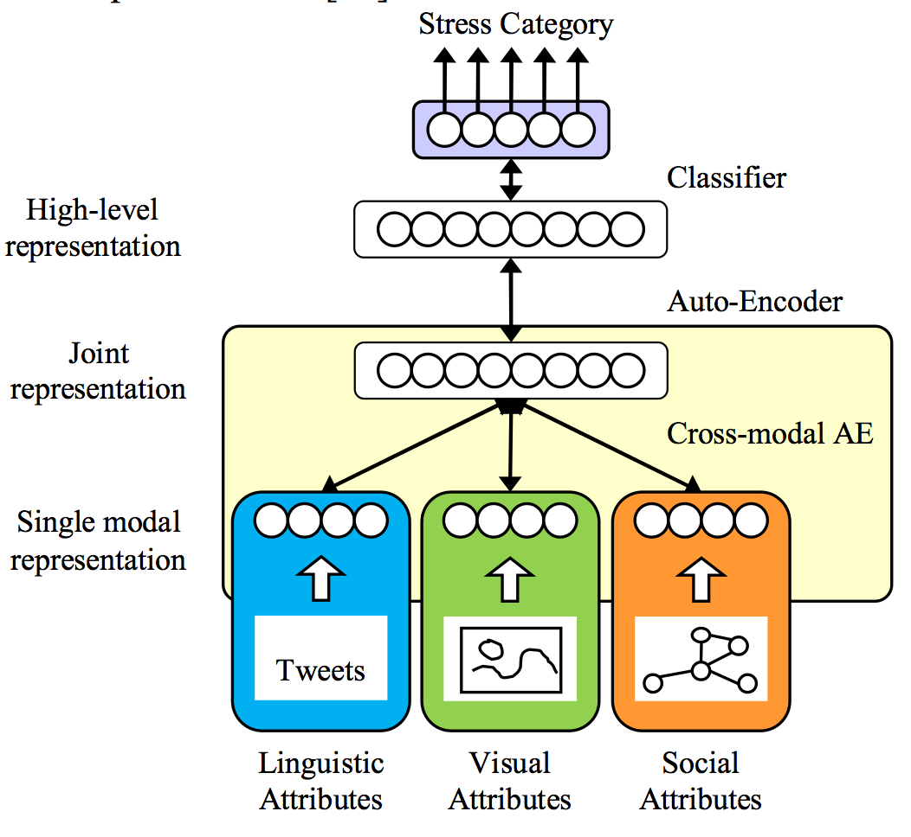
Modeling
We propose a cross-media auto-encoder (CAE) to learn a joint representation from the cross-media social media data, which can solve the modality-missing problem.
We propose a cross-media auto-encoder
Lin & Jia. User-Level Psychological Stress Detection from Social Media Using Deep Neural Network.
ACM Multimedia 2014
Notes:
To leverage both tweet-level and user-level features, we propose a hybrid detection model.
This is the architecture of our model for cross-media stress detection. We propose a Cross-media Auto-Encoder (CAE) to learn the joint representation using Denoising Auto-Encoder (DAE) style learning.
With training data containing all three modality information, we manually disable image representation and/or social representation when training the auto-encoder, while requiring it to reconstruct all three. In this part of training, thought the missing part of data did not contribute as input, they enforce the network to reconstruct them even if they are missing.

Slide 29
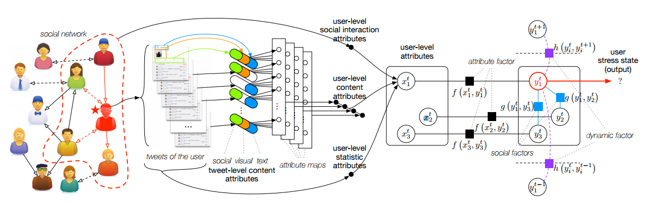
Modeling
We propose a hybrid model combining Factor Graph model with CNN+CAE, to model the correlations of users’ social interactions and time-series tweet content
Lin & Jia. Detecting Stress Based on Social Interactions in Social Networks. TKDE 2017.
Notes:
We further apply a one-dimension convolutional neural network (CNN), with CAE units listed in the attribute maps, to aggregate the user’s single tweets in the time-series and acquire user-level content attributes The user-level attributes are subsequently combined with dynamic temporal factors and social correlation factors within a partially-labeled factor graph (PFG) for final stress detection

Slide 30
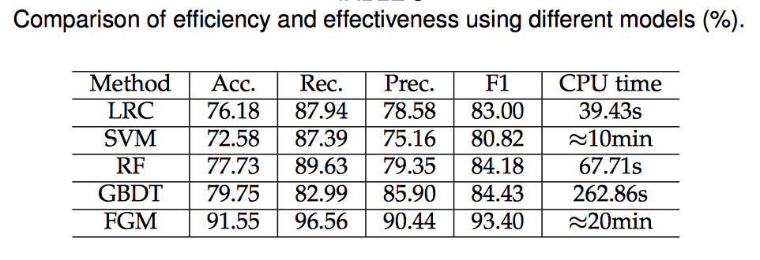
Performance
Performance:
93.40% F1-Measure on Sina Weibo dataset D1
87.85% F1-Measure on Sina Weibo with PSTR label dataset D2
88.32% F1-Measure on Tencent Weibo dataset D3
82.24% F1-Measure on Twitter dataset D4
Lin & Jia. Detecting Stress Based on Social Interactions in Social Networks. TKDE 2017.
Notes:
And this is the performance of our method, which achieves 93.40% in terms of F1-measure on dataset DB1, far better than other baselines. Results on other datasets are also desirable, indicating that our method is universally applicable.

Slide 31
Research 2： Stressor and Stress Level Detection

Slide 32
Beyond Binary Classification
Research II
Our work: stressor and stress level detection via social media
Motivation:
Stress is composed of two key factors: stressor subject and stress level
Different stressors incur different stress levels
Stress is normal while over-whelming stress is terrible– for providing appropriate proactive care
Solutions:
Extract a set of discriminant features
Propose a hybrid model combining multi-task learning with CNN to identify the stressor subjects and stressor events of given social posts
Lookup a standard psychological stress scale to measure the precise stressor and stress level (Social Readjustment Rating Scale)
Notes:
Beyond Binary Classification, we work towards more well-rounded stress detection by measuring two key factors, stressor and stress level.
Our motivation is that: Stress is composed of two key factors: stressor subject and stress level. Different stressors incur different stress levels. And Stress is normal while over-whelming stress is terrible, for which appropriate proactive care is in need.
We devise a comprehensive scheme to automatically detect the stressor events and subjects, and therefore estimate the stressor and stress level by looking up an expert- defined stress table.

Slide 33
Dataset
Collection Method
Manually deﬁne a set of keyword patterns collected from the LIWC dictionary for each stressor event category.
Filter matched tweets from the aforementioned one billion Weibo dataset.
Collect the top 12 stressor event categories and invited 30 volunteers to manually label the stressor events and stressor subjects of the tweets.
Dataset composition
Nearly 2,000 stressed posts, each with a stressor event label and a stressor subject label.
Randomly selected 600 non-stressed posts as negative samples
Each sample is a single tweet
Lin & Jia. What does Social Media Say about Your Stress? (IJCAI 16)

Slide 34
Dataset
Example Text | Subject | Events | Score
My sister give birth to a child today. | Relative | Marriage | 39
I am very angry about my boss! | I | Blamed | 23
My wife passed away in accident recently. | Spouse | Death | 100
My daughter caught flu this week. | Family | Illness | 45
One of my roommate failed in the exam. | Friend | School | 26

Slide 35
Hybrid model combining multi-task learning with CNN
1) Description component that extracts features from input tweets;
2) Detection component that integrates handcrafted and CNN features with Multi-Task Learning (MTL) for stress or event and subject detection;
3) Measurement component leveraging a psychological stress scale to estimate the stressor and the corresponding stress level.
Lin & Jia. What does Social Media Say about Your Stress? (IJCAI 16)
Notes:
To perform stressor and stress level detection, we further construct a stressor event and subject dictionary for each predefined category by expanding the seed words based on the word embeddings learned over the one billion tweets. Therefore, we comprehensively describe each tweet by extracting the word distribution of stressor events and subjects, and combining them with high-level features learned by CNN. Since the stressor events and subjects are closely connected, we propose a multi-task learning (MTL) model for detection, which can adaptively capture the relatedness among tasks, and leverage the shared patterns to strengthen the performance. We further enhance the MTL model with stacked auto-encoders and propagate the gradient of the final multi-task learning layer to fine-tune the convolution layer and improve the learnt features of the CNN. With stressor event and stressor subject detected, we employ the Social Readjustment Rating Scale, a widely-accepted stress metric, to estimate the stressor and the corresponding stress level

Slide 36
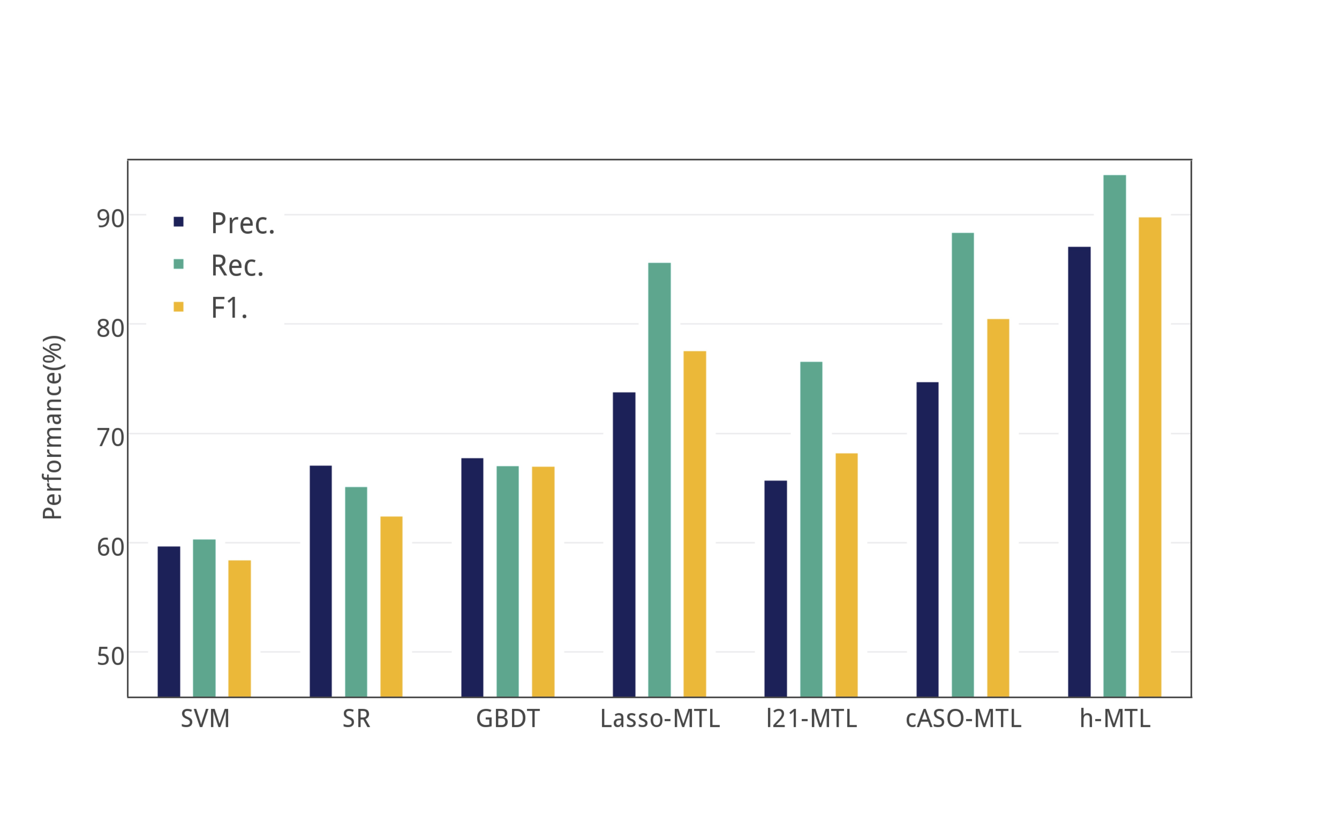
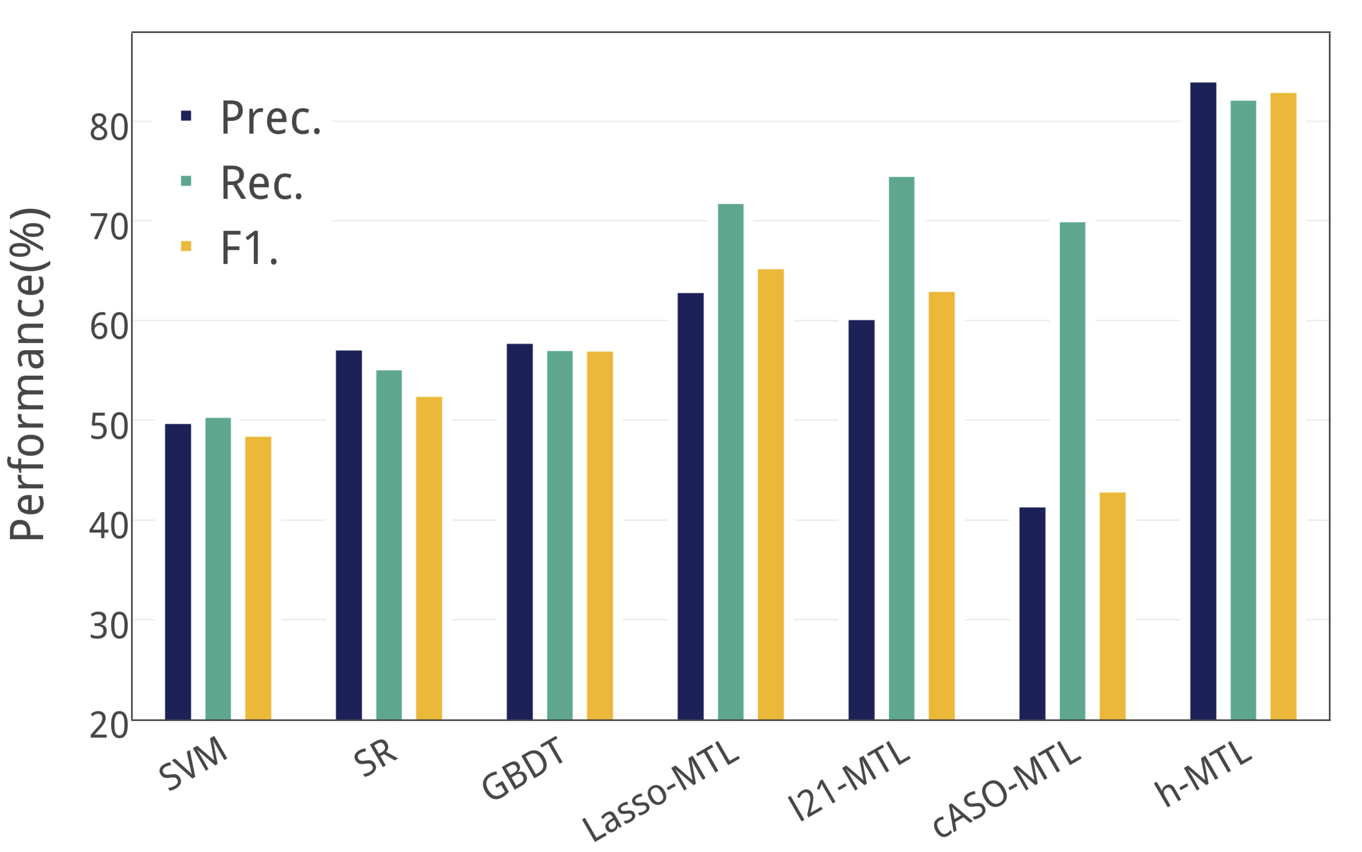
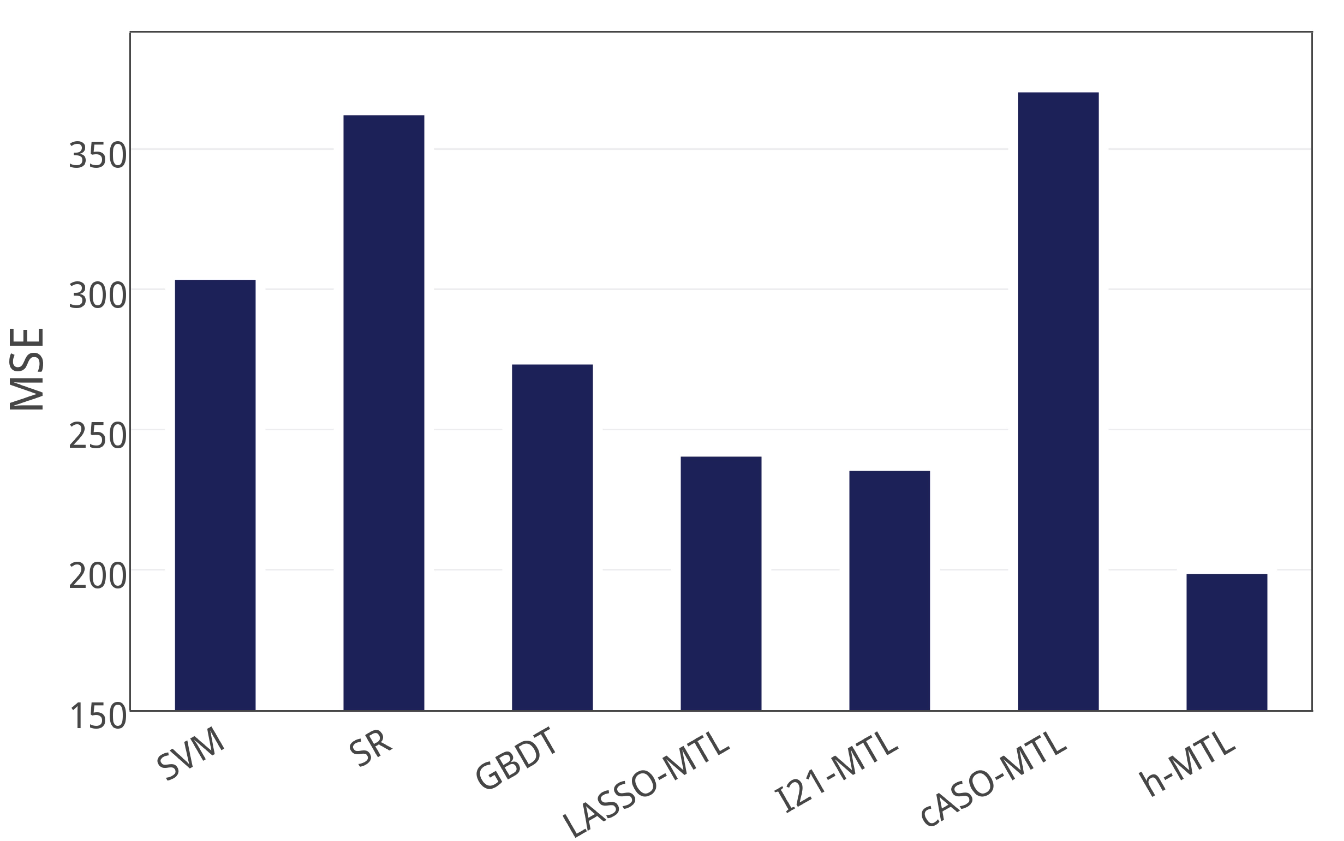
Performance
(a) Stressor Event Detection
(b) Stressor Subject Detection
F1-Measure
Stressor Event Detection: 90%
Stressor Subject Detection: 81%
(c) Stress Level Measurement
Notes:
In experiments, we evaluate the performance of stressor event and subject detection, together with stress level measurement. In all the tasks, our hybrid model significantly outperforms the com- pared methods, including other multi-learning models, which demonstrates that our scheme achieves promising results on measuring stress.

Slide 37
Research 3：Depression Detection via Harvesting Social Media
Notes:
We also work towards depression detection via harvesting social media. While depression and stress are both common mental problems, depression is much more severe, defined as a clinical disease. Following the previous scheme of stress detection, we conduct our preliminary work of binary depression detection on Twitter

Slide 38
Motivation
Depression is a leading cause of disability worldwide
350 million people of all ages suffer from depression
Clinical diagnosis is effective
Make face-to-face interviews referring to DSM criteria
Nine classes of depression symptoms are deﬁned in the criteria, describing the distinguishing behaviors on daily lives
But clinical diagnosis is not proactive
More than 70% of people in the early stages of depression would not consult the psychological doctors
People are increasingly relying on social media platforms
User generated contents (UGC) reflect daily lives and moods
Online behaviors are not covered in previous depression criteria

Slide 39
A Multimodal Dictionary Learning Solution
Our work: Binary depression detection via harvesting multimodal social media
Challenges:
No public available large-scale benchmark datasets
Users’ behaviors on social media are multi-faceted
Few users’ behaviors are symptoms of depression
Solutions:
Construct well-labeled datasets by rule-based heuristic methods
Extract six groups of depression-oriented features
Leverage multimodal dictionary learning method
Shen&Jia. Depression Detection via Harvesting Social Media: A Multimodal Dictionary Learning Solution (IJCAI 17’)

Slide 40
Dataset
Dataset D1
1400 depressed samples selected by sentence pattern labeling (e.g. “I’m diagnosed depression”).
1400 non-depressed samples that have never published tweets containing the key word “depress”.
Dataset D2
37000 depression-candidate samples, selected by just loosely contained the character string “depress”.
Each sample include：
4 weeks of tweets data + user profile
Shen&Jia. Depression Detection via Harvesting Social Media: A Multimodal Dictionary Learning Solution (IJCAI 17’)
Notes:
For dataset construction, we employ the strict self-report pattern “I am diagnosed depression” for ground truth la- beling and find 1,402 depressed users. Users are labeled as non-depressed if no tweets containing “depress” were published in the sampling period. By loosely matching the word “depress”, we also construct a large depression candidate dataset for online behavior analysis
According to ICD-10, here, a period of four weeks of tweet data is gathered to study each user’s depression state.

Slide 41
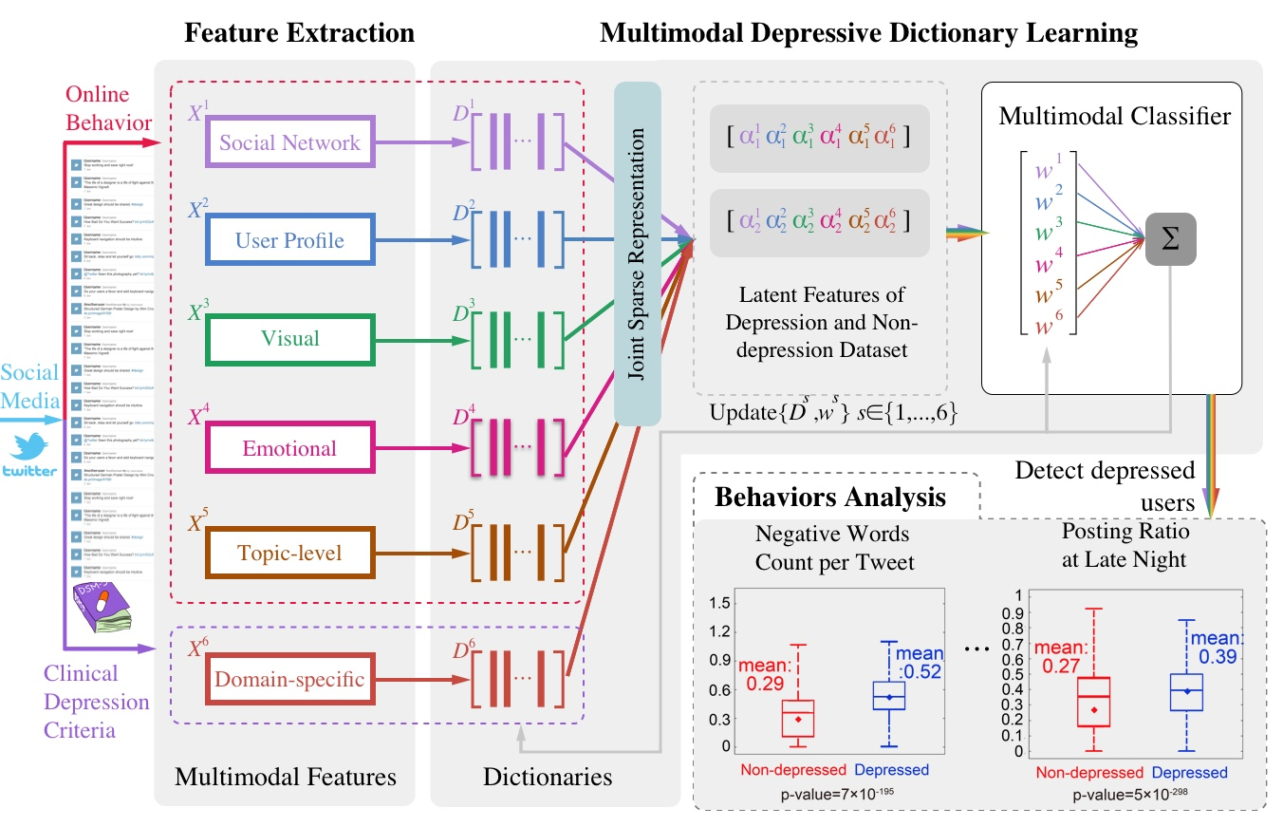
Multimodal dictionary learning
Shen&Jia. Depression Detection via Harvesting Social Media: A Multimodal Dictionary Learning Solution (IJCAI 17’)
Notes:
Construct well-labeled datasets by rule-based heuristic methods
Extract six groups of depression-oriented features with reference to typical online behavior and clinical depression criteria

Slide 42
Methods & Experiments
Method: multimodal dictionary learning
General idea:
Why dictionary learning
learning the latent and sparse representation
Why multimodal learning
jointly modeling the cross-modality relatedness to capture the common patterns and learn the joint sparse representations
Train a classiﬁer to detect depressed users with the learned features speciﬁcally
Performance: 85% F1-Measure on D1 & D2
Shen&Jia. Depression Detection via Harvesting Social Media: A Multimodal Dictionary Learning Solution (IJCAI 17’)
Notes:
We propose a multi-modal depressive dictionary learning (MDL) model for detection. We learn the latent and sparse representation of users by dictionary learning, and thus extend it to multimodal, so as to model cross modality relatedness, capture the common patterns, and learn the joint sparse representation. Finally, we train a binary classifier with the learned features based on cumulative loss to detect depressed users. We conduct experiments on the labeled dataset and our MDL model achieves 85% in terms of F1- measure, outperforming the baselines by +3% to +10%.

Slide 43
Depression Behaviors Discovery in Twitter
Posting time. Depressed users post more tweets between 23:00 and 6:00, indicating that they are susceptible to insomnia.
Emotion catharsis. All users say about their bad moods, but depressed users express more emotions, especially negative emotions.
Self-awareness. Depressed users use more ﬁrst personal pronouns, which may reﬂect their suppressed monologues and strong senses of self-awareness.
Live sharing. Depressed users post more antidepressant and depression symptom words, indicating that they are willing to share what they encountered in the real life.

Slide 44
Research 4：Cross-domain Depression Detection
Notes:
We further focused on cross-domain depression detection,

Slide 45

Cross-Domain depression detection
Motivation:
Success of depression detection in Twitter (Source Domain)
Probably insufficient labeled (self-reported depression) samples for model training in other platforms (Target Domain, e.g. Weibo), due to cultural differences
Utilizing the source domain dataset to improve depression detection performance for a target domain
Match the pattern “I am diagnosed with depression” in 100 million randomly crawled tweets:
481 users accessed in Twitter
142 users accessed in Weibo
Shen&Jia. Cross-Domain Depression Detection via Harvesting Social Media (IJCAI’18)
Notes:
While achievements of depression detection have been made in Twitter, we have to admit that the online depression dataset is an order of magnitude smaller than the stress dataset. It is the sufficient labeled training data that paves the way for effective mental problem detection via social media. However, due to cultural differences, including the distinctive attitudes towards mental diseases and disparate online discussion environment, replicating the self-report sentence pattern labeling method to different social media platforms may encounter difficulties. Specifically, with the same pattern, dramatically fewer depressed users can be obtained in Weibo than in Twitter with the same quantity of randomly crawled tweets. This leads us to a novel but challenging idea: can we utilize the multi-source datasets to improve depression detection performance for a specific platform?

Slide 46
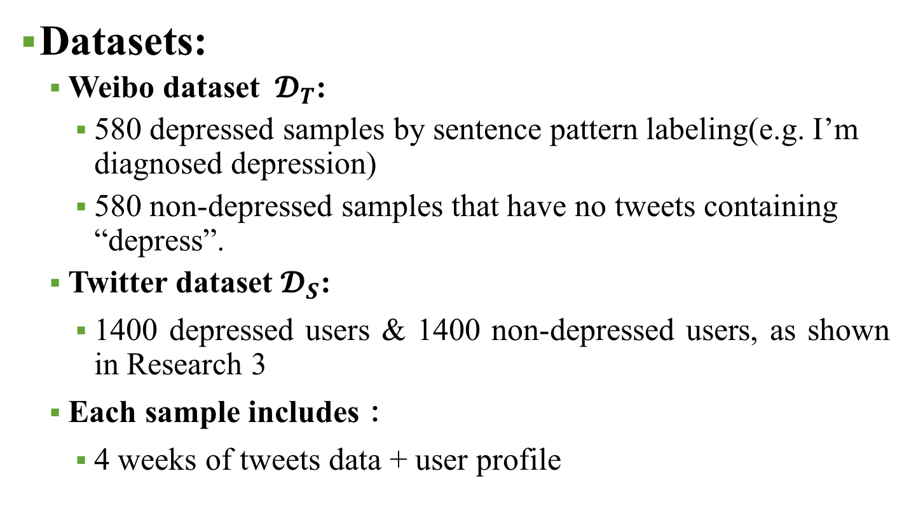
Datasets
Datasets:
Weibo dataset ${ 𝓓}_{T}$:
580 depressed samples by sentence pattern labeling(e.g. I’m diagnosed depression)
580 non-depressed samples that have no tweets containing “depress”.
Twitter dataset $𝓓_{S}$:
1400 depressed users & 1400 non-depressed users, as shown in Research 3
Each sample includes：
4 weeks of tweets data + user profile
Shen&Jia. Cross-Domain Depression Detection via Harvesting Social Media (IJCAI’18)
Notes:
In this work, we take Twitter and Weibo as the source and target domain respectively.
Weibo dataset DT was constructed by sentence pattern labeling, including 580 depressed samples and 580 non-depressed samples.
Twitter dataset DS contains 1400 depressed users & 1400 non-depressed users, as shown in Research 1.
Each sample includes 4 weeks of tweets data and user profiles.

Slide 47
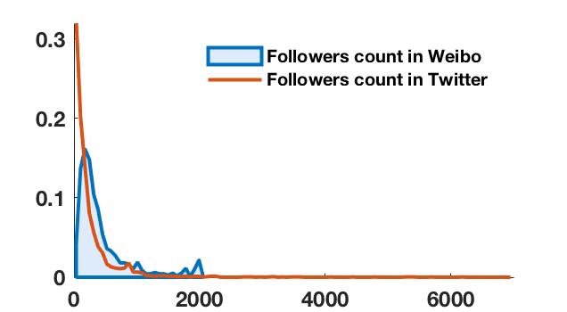
Detection Challenges
Isomerism: one feature may follow distinctive integral (irrelevant to specific user groups) distributions across domains
Notes:
We investigate the distributions of features and summarize two major detection challenges regarding cross-domain feature patterns.
First, Isomerism. That is to say, one feature may follow distinctive integral distributions in different domains. The definition is unrelated to specific user groups. Taking followers count for instance, a cap of 2000 is imposed in Weibo and the feature distribution varies greatly in the two platforms.

Slide 48
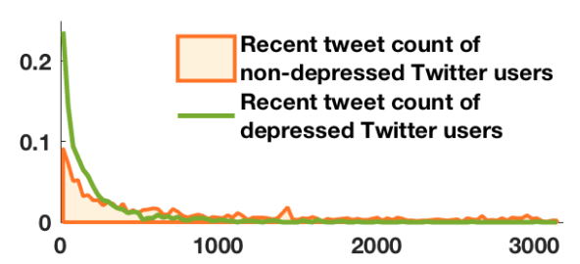
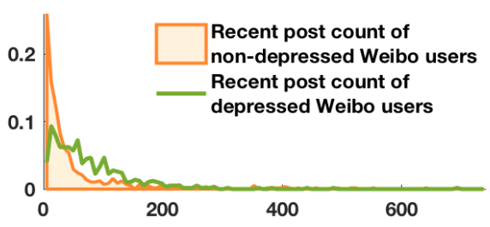
Detection Challenges
Isomerism: one feature may follow distinctive integral (irrelevant to specific user groups) distributions across domains
Divergency: one feature may have distinctive, or even opposite implications on depression detection in different domains
Notes:
Second, Divergency, which means one feature may have distinctive, or even opposite implications on depression detection in different domains.
Recent tweet count is such a divergent feature.

Slide 49
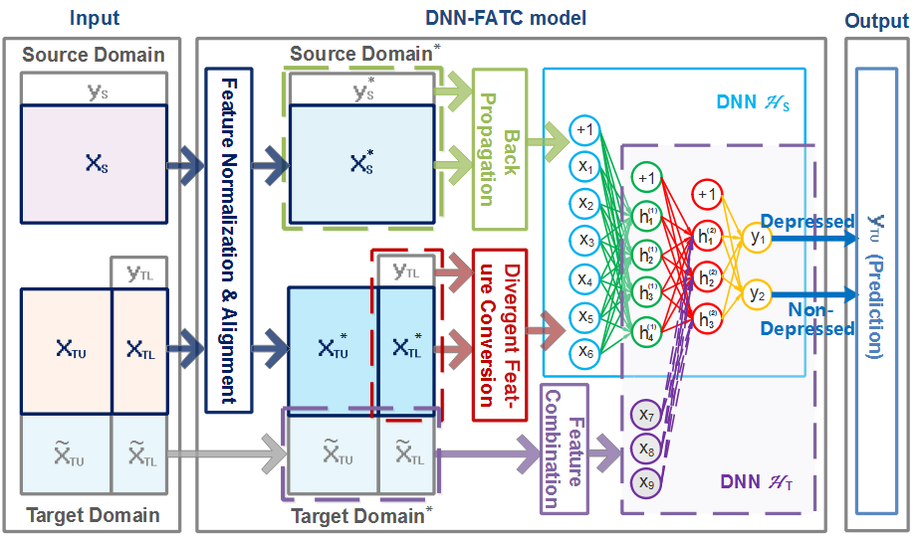
Framework
Source domain: Twitter Target domain: Weibo
Shen&Jia. Cross-Domain Depression Detection via Harvesting Social Media (IJCAI’18)
Notes:
Leveraging the discoveries, we propose a cross-domain Deep Neural Network model with Feature Adaptive Transformation & Combination strategy (DNN-FATC) that utilizes the source domain data to enhance mental problem detection in the target domain.

Slide 50
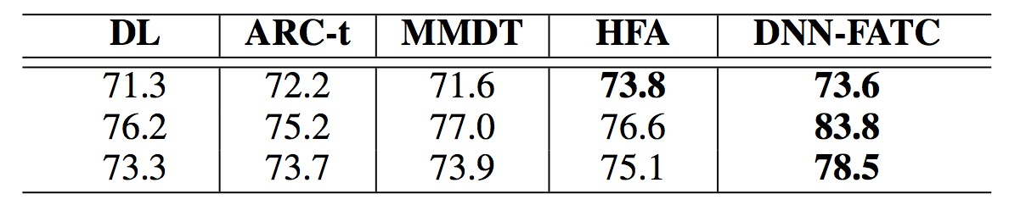
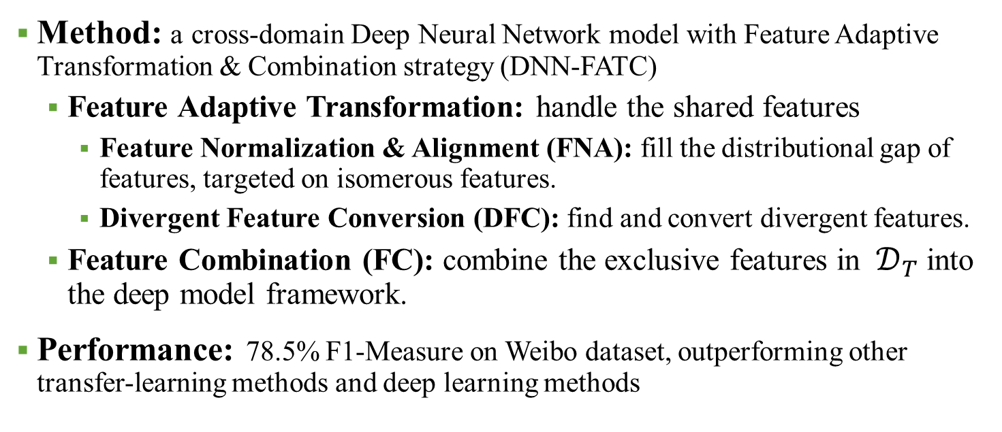
Method and Experiments
Method: a cross-domain Deep Neural Network model with Feature Adaptive Transformation & Combination strategy (DNN-FATC)
Feature Adaptive Transformation: handle the shared features
Feature Normalization & Alignment (FNA): fill the distributional gap of features, targeted on isomerous features.
Divergent Feature Conversion (DFC): find and convert divergent features.
Feature Combination (FC): combine the exclusive features in ${ 𝒟}_{T}$ into the deep model framework.
Performance: 78.5% F1-Measure on Weibo dataset, outperforming other transfer-learning methods and deep learning methods
Shen&Jia. Cross-Domain Depression Detection via Harvesting Social Media (IJCAI’18)
Notes:
For the shared features, we first perform transformations of feature normalization & alignment (FNA) to fill the distributional gap of features, or in other words, to reduce isomerism. We then train a deep neural network (DNN) classifier on the transformed source domain data. To cope with divergency, we devise a divergent feature conversion (DFC) approach to recognize the divergent features and thereby conduct a targeted transformation. From this way, we take full advantage of the rich source domain data, and the model trained in the source domain can be well adapted to the target domain. We ultimately combine the exclusive features in the target domain into the deep framework with feature combination (FC) method, where we train another DNN based on the previous one to incorporate all the features.
We conduct a series of experiments, by considering all the combinations of different processing approaches regarding normalization and utilization of the two domains, so that each part of our model can be validated. The results show remarkable improvement is achieved as compared to both the existing heterogeneous transfer learning methods and directly training using the sparsely labeled source domain dataset. All these results verify the importance of considering both isomerism and divergency, and corroborate that mental problem detection can be enhanced with multi-source learning, and in particular, our DNN-FATC model is desirably effective.

Slide 51
Conclusion & Future Work

Slide 52
Conclusion
Current work:
Stage 1: Online detection of mental health problems
Future work:
Stage 2: Online-care of mental health problems
Find our applications by http://hcsi.cs.tsinghua.edu.cn/
Demo：Anidraw，Senserun, Anidance
Stage 3: Combination with offline researches

Slide 53
Thanks & Any question？

